Slide 1
Module 2: Managing Your Source Code with Git
By,
GOWTHAM R NAIK

Slide 2
Introduction
A few years ago, when we were developers and writing code as part of a team, we encountered recurring problems that were for the most part as follows:
• How to share my code with my team members
• How to version the update of my code
• How to track changes to my code
• How to retrieve an old state of my code or part of it

Slide 3
Over time, these issues have been solved with the emergence of source code managers, also called a version control system (VCS) or noted more commonly as a version control manager (VCM).
The goals of these VCSs are mainly to do the following:
• Allow collaboration of developers' code
• Retrieve the code
• Version the code
• Track code changes

Slide 4
A version control system (VCS) is software that tracks changes to files over time, so you can review history, restore earlier versions, and collaborate without overwriting each other’s work.
Examples
Git
Subversion (SVN)
Mercurial
For example, in a software project, Git lets multiple developers work on the same code, save changes as commits, and merge updates safely.

Slide 5
Getting started with Git, Technical requirements
The use of Git does not have any technical prerequisites
Installation of Git
https://www.youtube.com/watch?v=9BbS46HwjBM

Slide 6
Overviewing Git and its principal command lines
There are two types of VCSs:
1.centralized
2. Distributed systems.

Slide 7
Centralized source control
Subversion (SVN), Concurrent Version System (CVS), and Team Foundation Version Control (TFVC) and Microsoft Visual SourceSafe (VSS). These systems consist of a remote server that centralizes the code of all developers.
All developers can archive and retrieve their code on the remote server. The system allows better collaboration between teams and a guarantee of code backup. However, it has its drawbacks, such as the following:
• In case of no connection (for a network problem or internet disconnection) between the developers and the remote server, no more archiving or code recovery actions can be performed.
• If the remote server no longer works, the code, as well as the history, will be lost.

Slide 8
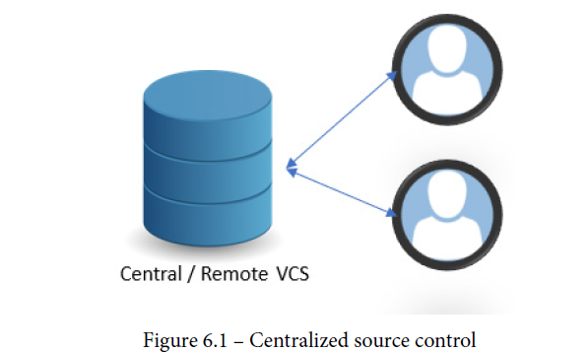

Slide 9
Distributed system
These systems consist of a remote repository and a local copy of this repository on each developer's local machine.
with this distributed system, even in the event of disconnection from the remote repository, developers can continue to work with the local repository, and synchronization will be done when the remote repository is accessible again. A copy of the code and its history is also present in the local repository.

Slide 10
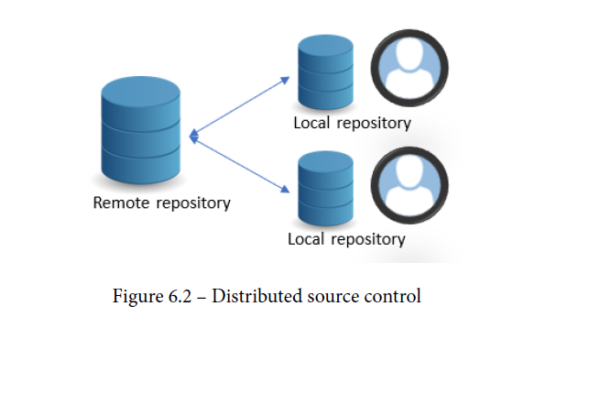

Slide 11
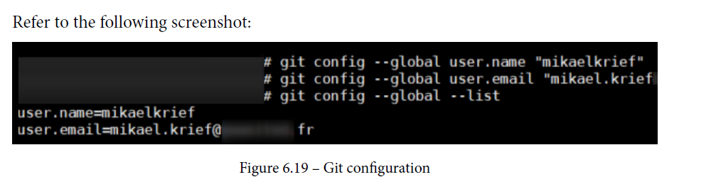
Git configuration
git config --global user.name "<your username>"
git config --global user.email "<your email>"
Then, we can check the configuration values by executing the following command:
git config --global –list

Slide 12
Useful Git vocabulary
Repository: A repository is the basic element of Git; it is the storage space were the sources are tracked and versioned. There are remote repositories that centralize a team's code and allow team collaboration. There is also the local repository, which is a copy of the local repository on the local machine.
Clone: Cloning is the act of making a local copy of a remote repository.
Commit: A commit is a change made to one or more files, and the change is saved to the local repository. Each commit is unique and is identified by a unique number called SHA-1, by which code changes can be tracked.

Slide 13
Branch: The code that is in the repository is stored by default in a master branch.
A branch can create other branches that will be a replica of the master on which
developers make changes, and that will allow us to work in isolation without
affecting the master branch. At any time, we can merge one branch with another.
Merge: This is an action that consists of merging the code of one branch with another.
Checkout: This is an action that allows us to switch from one branch to another.
Fetch: This is an action of retrieving the code from the remote repository without merging it with the local repository.

Slide 14
Pull: This is an action that consists of updating your local repository from the remote repository. A pull is equivalent to a fetch and merge operation.
Push: A push is the reverse action of a pull—it allows us to update the remote repository from the local repository.
Pull request (PR): A PR is a Git feature (initiated by GitHub) that provides a
graphical user interface (GUI) client or web interface for discussing proposed changes, between teams' users, before integrating them into the main branch.

Slide 15
git init — Create a new repository.
git clone <url> — Copy an existing repository.
git status — Show changed, staged, and untracked files.
git add <file> — Stage a file.
git add . — Stage all current changes.
git commit -m "message" — Save staged changes.
git log — Show commit history.
git branch — List branches.
git switch <branch> — Switch branches.
git switch -c <branch> — Create and switch to a new branch.
git merge <branch> — Merge a branch into the current branch.
git pull — Fetch and merge remote changes.
git fetch — Download remote changes without merging.
git push — Upload local commits to a remote.
git remote -v — Show remote repository URLs.
git stash — Save uncommitted work temporarily.
git restore <file> — Discard local changes in a file.

Slide 16
Quick example
bash
git clone https://github.com/user/repo.git
cd repo
git switch -c feature-login
git add .
git commit -m "Add login feature"
git push origin feature-login

Slide 17
Git command lines
1.Retrieving a remote repository:
git clone <url of the remote repository>
2. Initializing a local repository: git init
3. Configuring a local repository
git remote add <name> <url of the remote>
4. Adding a file for the next commit
git add <files path to add>
5. Creating a commit:git commit -m "<your commit message>"

Slide 18
6. Updating the remote repository:git push <alias> <branch>
7. Synchronizing the local repository from the remote:
git pull
git fetch
8. Managing branches
git branch <name of the desired branch>
git checkout <name of the branch>
git merge <branch name>
git branch

Slide 19
Understanding the Git process and Gitflow pattern
Here are the steps of the Git process that we will discuss in detail in this section:
1. The first developer commits the code on the local repository and pushes it to the
remote repository.
2. Then, the second developer gets the pushed code from the remote repository.
3. The second developer updates this code, creates a commit, and pushes the new
version of the code to the remote repository.
4. Finally, the first developer retrieves the last version of the code in the local
repository.

Slide 20
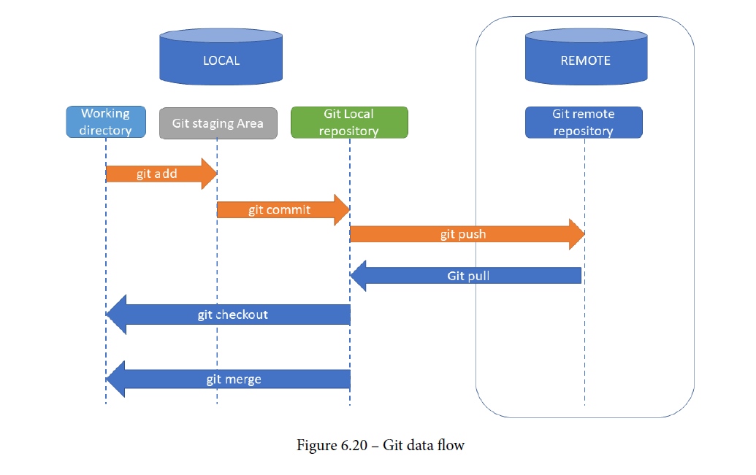

Slide 21
Branching strategy with Gitflow, Gitflow tools
1. First of all, we have the master branch, which contains the code that is currently in
production. No developer is working directly on it.
2. From this master branch, we create a develop branch, which is the branch that
will contain the changes to be deployed in the next delivery of the application.
3. For each of the application's functionalities, a feature/<name of the
feature> branch is created (/ will hence create a feature directory) from the
develop branch.
4. As soon as a feature is finished being coded, the branch of the feature is merged into
the develop branch.
5. Then, as soon as we want to deploy all of the latest features developed, we create a
release branch from develop.

Slide 22
6. The release branch content is deployed in all environments successively.
7. As soon as the deployment in production has taken place, the release branch
is merged with the master branch, and, with this merge operation, the master
branch contains the production code. Hence, the code that is on the release
branch and feature branch is no longer necessary, and these branches can be
deleted.
8. If a bug is detected in production, we create a hotfix/<bug name> branch;
then, once the bug is fixed, we merge this branch into the master and develop
branches to propagate the fix on the next branches and deployments.

Slide 23
